Slide 1

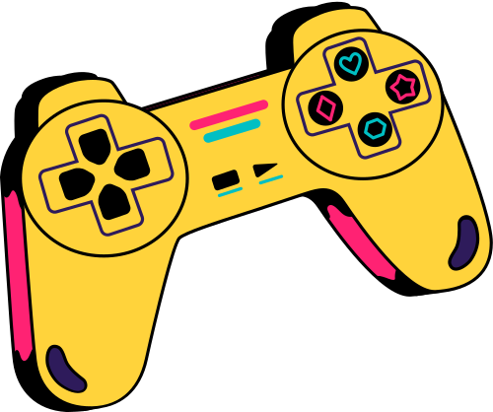
Welcome To Presentation
I’m Pritesh Bhere, and I'll be sharing with you my beautiful ideas.

Slide 2





Ninja Fight
Game
START

Slide 3





Table Of Contents
1
2
3
Introduction
About The Game
Game Process
Introduction to the subject, purpose and objectives of the game.
Important points of the game, advantages, drawbacks and future scope.
A brief overview of the game’s rules, controls, steps and game process.

Slide 4
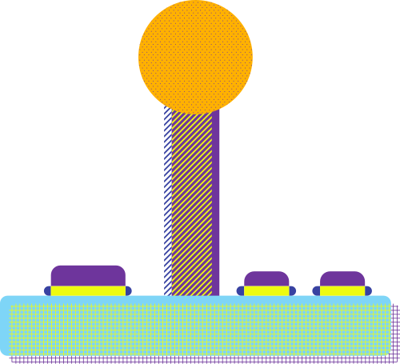


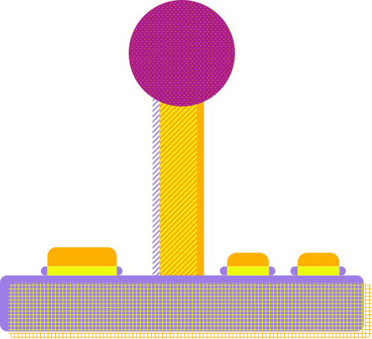
Introduction
Introduction To The Subject, Purpose And Objective Of The Game

Slide 5
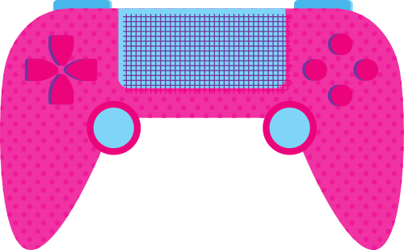


Introduction
Ninja Fight: Naruto vs Sasuke" is an engaging 2D fighting game developed using Python and Pygame, inspired by the Naruto anime . Players control Naruto, battling Sasuke across multiple levels with increasing difficulty. featuring dynamic combat, shuriken throws, and health potions. If you lose a round, you get a chance to play again.

Slide 6



About The Game
Important points of the game, Advantages, Drawbacks and Future scope.

Slide 7

Important Points For The Game
Hardware & Software
Frontend & Backend
File Formats Supported
Hardware Requirements
Processor : 1 GHz or higher
RAM : 2GB minimum(4GB recommended)
Storage : 100MB free space for code and assets
Display : 1024*768 resolution
Software Requirement
Operating System: Windows 7/10/11, Linux, mac OS.
Python : Version 3.6 or Higher.
Pygame : Latest version (installed via pip install pygame)
Fronted
Python with the Pygame library handles the graphical user interface, including rendering sprites, backgrounds, health bars, text, and sound playback.
Backend
Python manages game logic, event handling, file I/O for progress saving, and randomization for enemy behavior and backgrounds.
Image : PNG , JPG.
Audio : WAV , MP3.
Text : TXT (for progress saving).

Slide 8
Game:Advantages, Drawbacks,Future Scope
Advantages Of Game
Drawbacks Of Game
Future Scope
Engaging 2D fighting gameplay with Naruto and Sasuke.
Multiple levels with increasing difficulty and replay ability.
Features like pause, sound off and Progress saving.
Light weight, run on modest hardware.
Single-player only.
Limited character roster.
Desktop-only, no mobile/web support.
No settings for difficulty or controls.
Add multiplayer mode and more characters.
Improve Al and add new levels.
Support mobile / web platforms.
Include customizable settings, story mode or leaderboards.

Slide 9




Game Process
Start Screen
Level Selection
Gameplay Screen
Menu Screen
The game begins with a “Start” Button.
Level selection screen with buttons for levels 1-8 (locked levels appear grayed out.)
Naruto and Sasuke fight in the game play screen.
The pause menu allows the players to continue, retry, exit or mute the sound.

Slide 10



Game Process
A Brief Overview Of The Game’s Rules, Controls, Steps And Game Process.

Slide 11
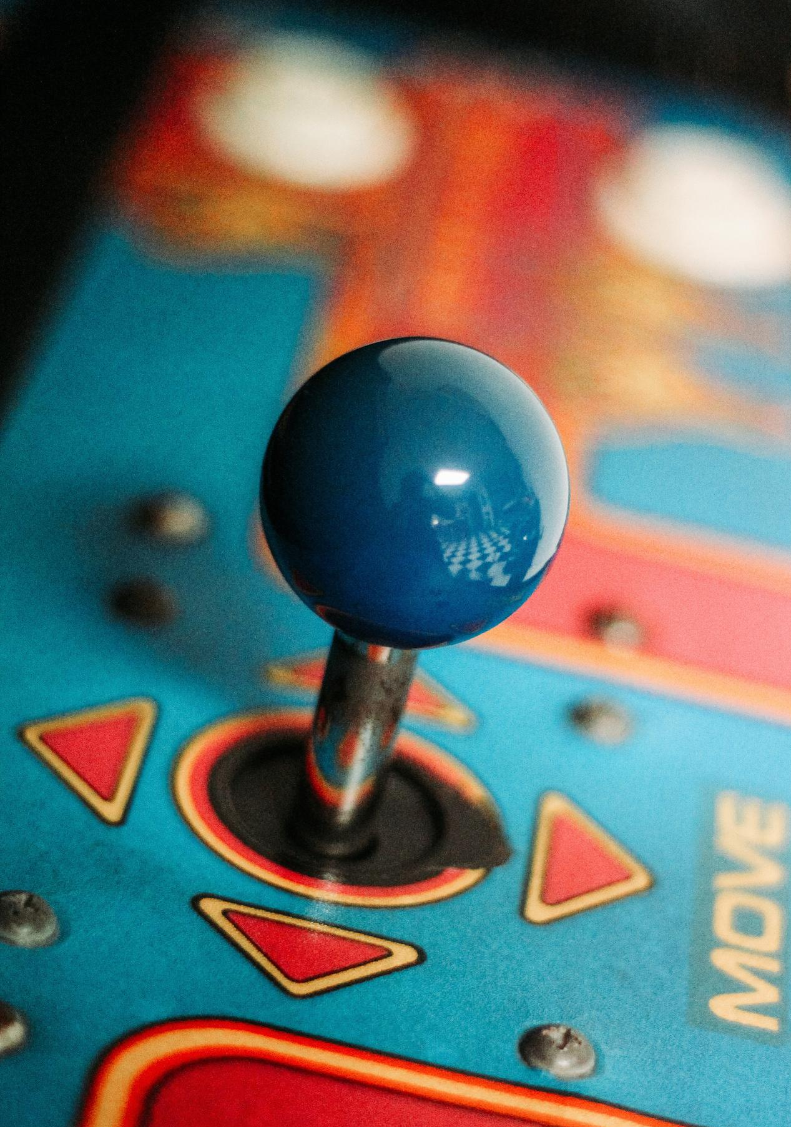
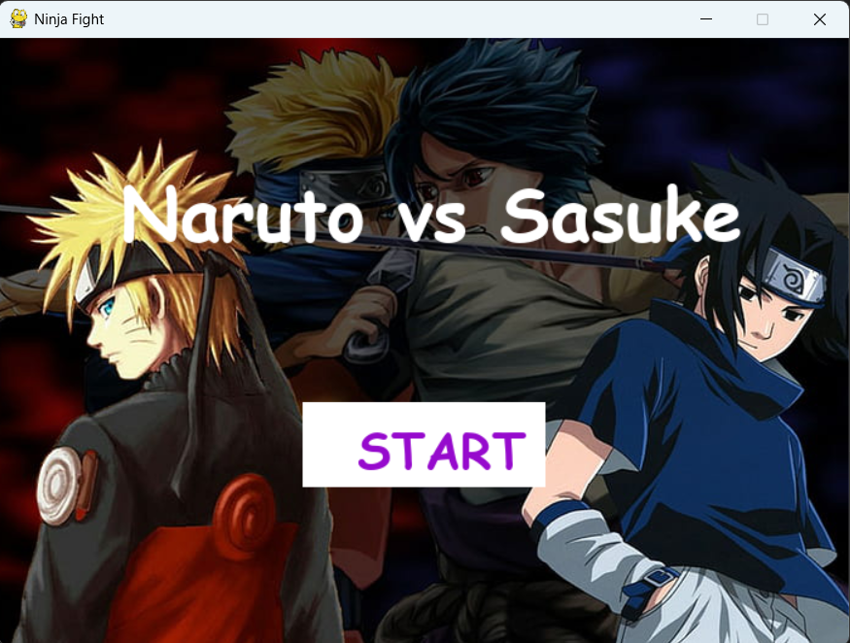

Start Screen
This is the welcome screen of the game displaying the title Naruto vs
Sasuke. The characters Naruto and Sasuke are prominently featured in
the background. The Start button allows the player to begin the game.
START

Slide 12
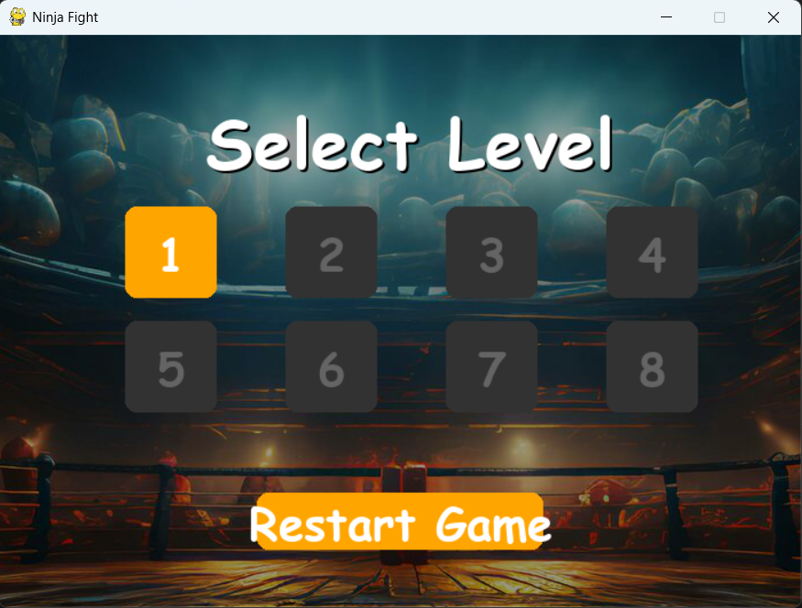
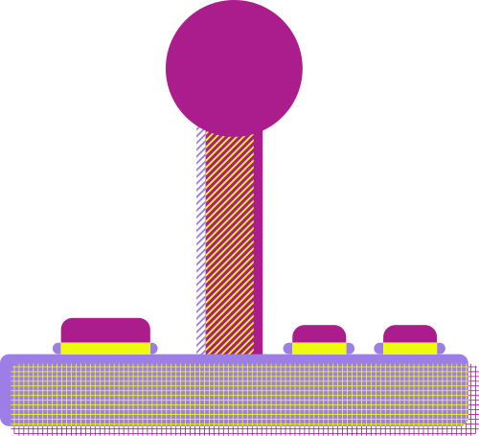
Level Selection
This screen allows the player to choose from multiple levels. Levels are displayed as buttons. Only level 1 is initially unlocked. The Restart Game button resets the game progress.

Slide 13
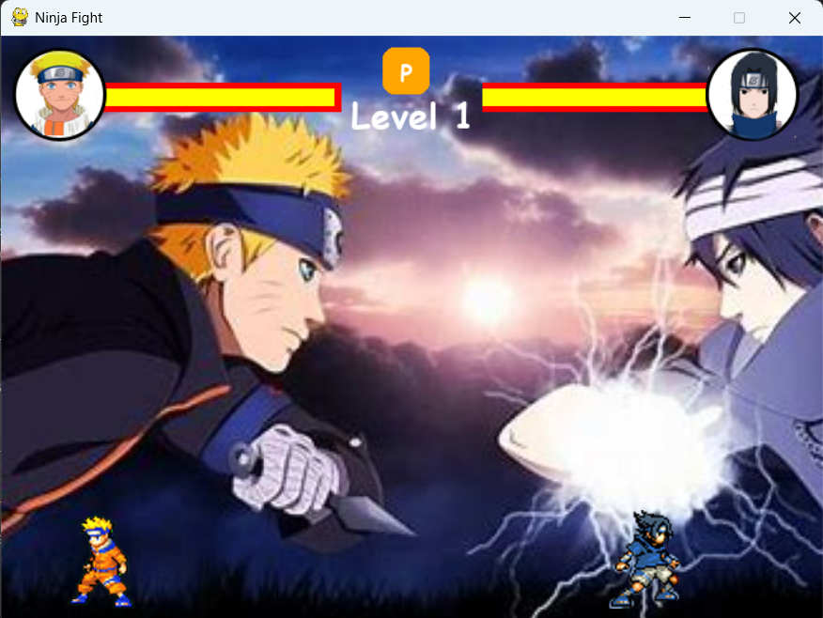


Gameplay Screen
Once a level begins, the screen displays a fight between Naruto and Sasuke. Both players have health bars. The current level is displayed at the top center. Small animated sprites represent each character in the lower corners.

Slide 14
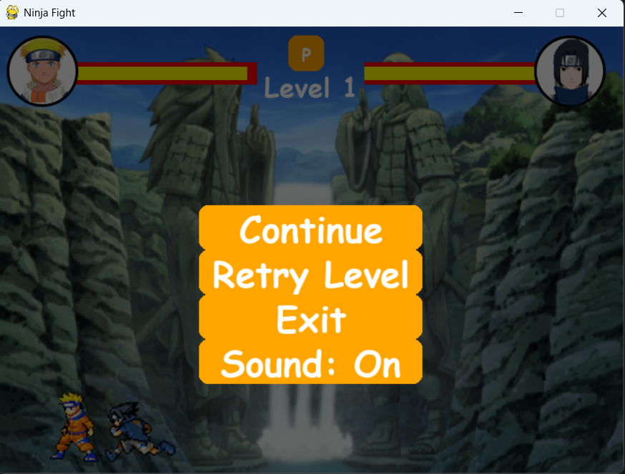




Menu Screen
The pause menu allows the player to continue, retry the level, exit, or toggle sound. It appears mid-game if the player pause during a fight.

Slide 15
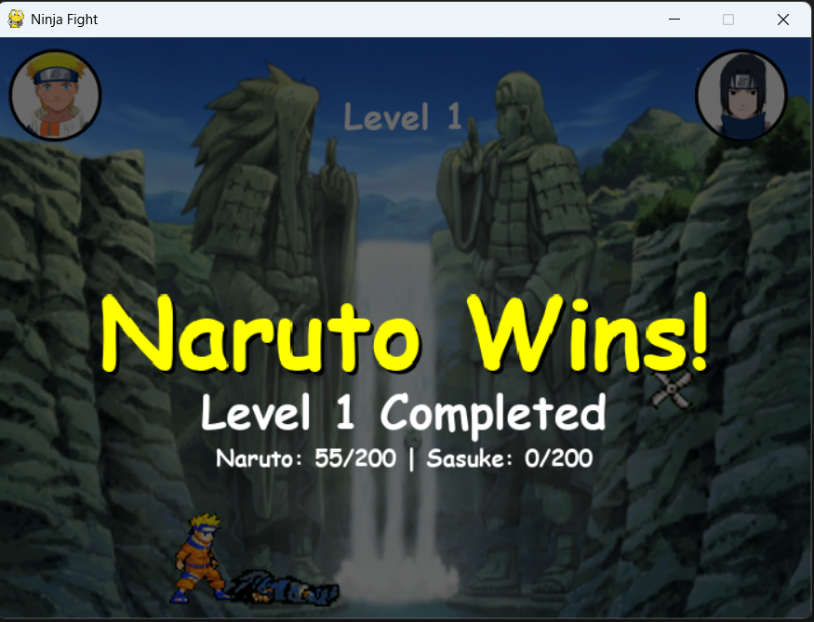
Naruto Wins
If the player successfully defeats Sasuke, a Naruto Wins screen is displayed. It confirms that the level is completed along with the final health statistics for both characters.

Slide 16
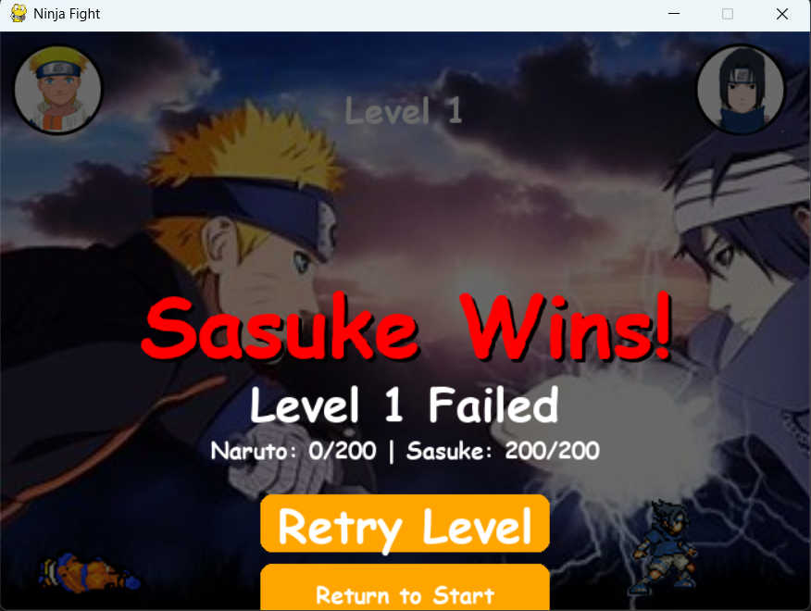

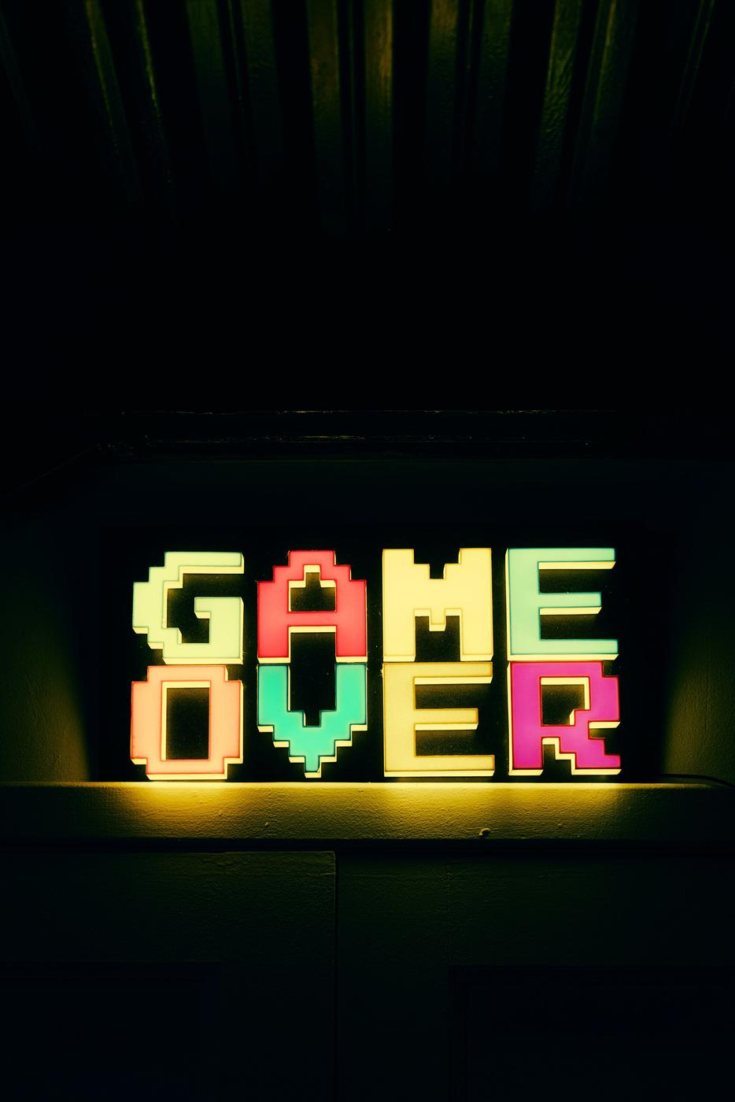
Sasuke Wins
If the player’s health reaches zero, a game over screen appears. In this case, Sasuke Wins, and the level is marked as failed. Options are available to retry the level or return to the start screen.

Slide 17

Thank you!
“Thank You For Watching Ninja Fight Game”

